Slide 1

COS40005 Computing Technology Project A
Week 2
Teamwork and Leadership

Slide 2
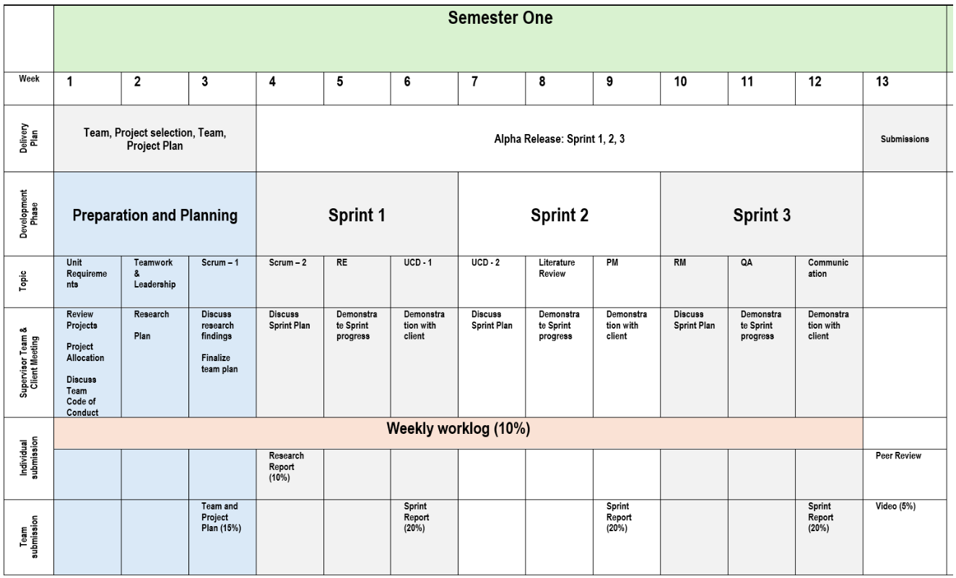
Roadmap

Slide 3
Challenges?
Submitted worklog
Have a team
Have a project
Have contact details of the client
In touch with the client
Not sure what I am doing?

Slide 4
Worklogs
Good worklog
Somewhat helpful
Not helpful?

Slide 5
Team plan
Team Roles
Team roadmap
Documents
Communication
Risks

Slide 6

What is a Team?

Slide 7

A team
small number of people
having complementary skills
are committed to a common purpose/goal
are accountable
Working together or collaboration

Slide 8
Developing a team
Forming
Storming
Norming
Performing
Adjourning

Slide 9

How do you manage your tasks?

Slide 10
Managing tasks
Do
If it’s urgent and important: do it now
Delegate
If it’s urgent and not important: delegate to someone else
Schedule
If it’s not urgent but it is important: schedule a time to do it later
Forget about
If it’s not urgent and not important: forget about it

Slide 11
Communication
Measure
- Introduction acknowledging the differences
- simplify speech, respectful
- Know each other
- Delegate if possible
- talking to person
- escalate
- Having processes in place to ensure visibility
- regular communication
- progress check
- Pair programming
- Progress tracking
Challenges
Cultural differences
Delays
Visibility
Non-aligned goals
One-way communication

Slide 12

Conflict
Challenges
  Cannot avoid
Measures
  In person meeting
  Open communication
  Find middle-ground
  Adaptive mindset
  Working out a solution
  Discuss pros and cons of both views

Slide 13

Leadership
Directive Autocrat
Permissive Autocrat
Directive Democrat
Permissive Democrat

Slide 14

QnA
Any questions?

